Slide 1
2022 USPS Calendar Year end

Slide 2
Reminder
Although the software is now written to permit districts to create and submit their own SSA, Ohio, City RITA, CCA & State files, ACCESS will continue to submit all
data to the respective entities on behalf of the districts.

Slide 3
2021 Changes – State Files
As of 2021, the State of Ohio encourages all employers to submit their W-2 information on Ohio Business Gateway electronically regardless of how many W-2 forms they issue
On the W2 State Options tab of the W2 Report, when Ohio is selected, the following must be filled out:
Contact Name
Contact Phone Number
Contact Email Address

Slide 4
Life Insurance Premiums (NC1)

Slide 5
IRS Publication 15-B

Slide 6
OSDI Code Review

Slide 7
City Tax Abbreviation

Slide 8
Rita Code

Slide 9
Residence vs employment

Slide 10
Check Legal Name Field

Slide 11
Quarter Report Totals Summary

Slide 12
Payroll item Balancing

Slide 13
W2 Report and submission error report

Slide 14
W2 Report and submission

Slide 15
Create w2 xml file

Slide 16
Create W2 Federal Submission file

Slide 17
Create W2 State Submission file

Slide 18
Create W2 city submission file

Slide 19
Create w2 rita submission file

Slide 20
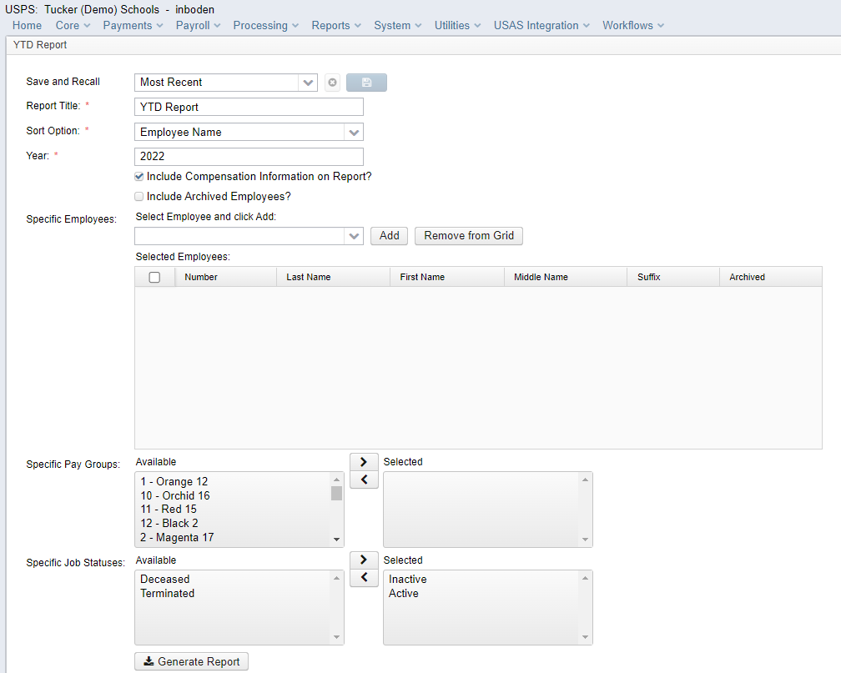
YTD report – earnings and benefits report

